Slide 1

Integrating R and Python scripts in Power BI

Slide 2
Integrating R and Python scripts in Power BI
R and Python scripts are programming tools that allow for advanced data manipulation, analysis, and visualization. Both languages are popular in data science for their unique capabilities and extensive libraries.

Slide 3

R Scripts
Purpose: R is primarily designed for statistical analysis and data visualization.
Capabilities: It offers a vast array of packages for statistical modeling, data visualization, and data manipulation, like ggplot2, dplyr, and caret.
Typical Use Cases: Ideal for data exploration, hypothesis testing, statistical modeling, and generating detailed graphics
Integration: R scripts can be integrated into tools like Power BI or SQL for specific analyses, making it versatile in data projects that require statistical depth.

Slide 4
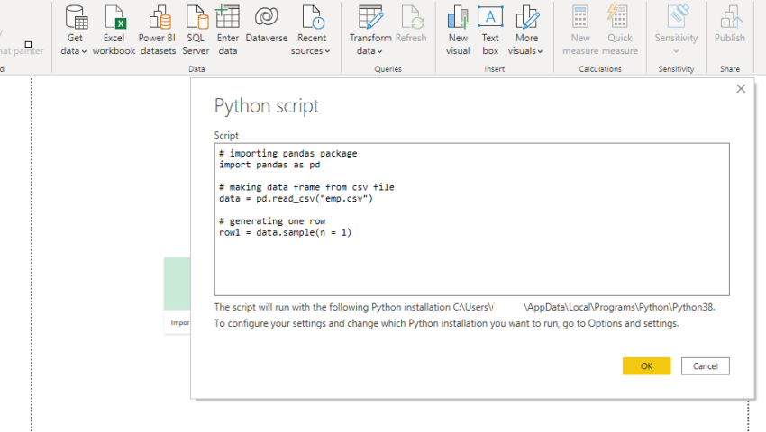
Python Scripts
Purpose: Python is a general-purpose language that excels in data manipulation, machine learning, and automation.
Capabilities: With libraries such as pandas, NumPy, scikit-learn, and matplotlib, Python is highly versatile for data cleaning, machine learning, and creating custom visualizations.
Typical Use Cases: Commonly used for data preprocessing, predictive modeling, machine learning workflows, and automating repetitive tasks.
Integration: Python is widely integrated into various data tools like Power BI, SQL, and Jupyter notebooks, making it popular in data engineering and machine learning pipelines.

Slide 5
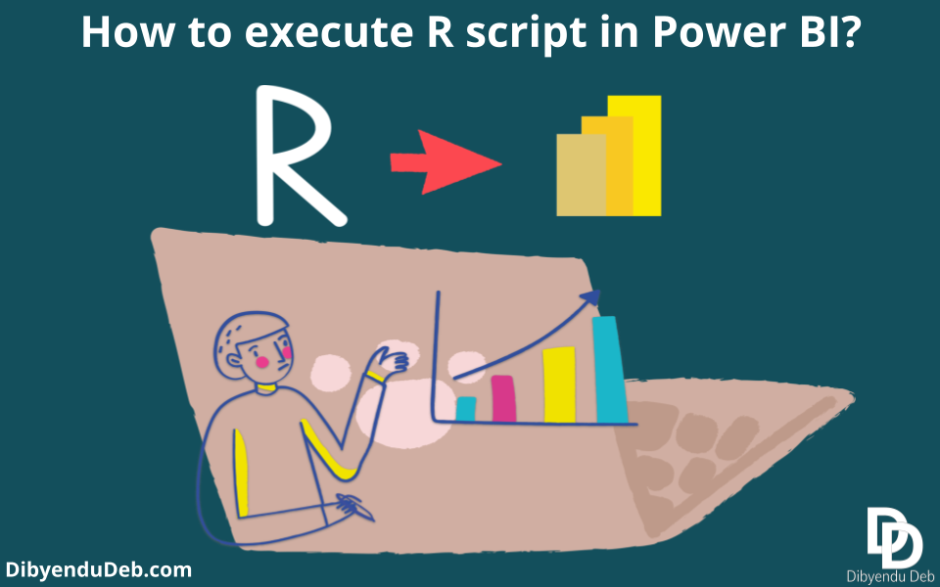
How it works
1. Enabling R and Python Scripts
In Power BI, you can run R and Python scripts within the Power Query Editor or as custom visualizations in reports.
To use these languages, you’ll need R or Python installed on your machine and set up in Power BI under Options > R scripting or Python scripting.

Slide 6
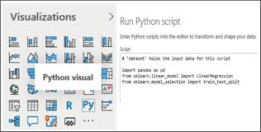
2. Using scripts in power query
In Power Query Editor, you can transform data using R or Python scripts by selecting Transform > Run R script or Run Python script.
This allows data analysts to perform complex data manipulations, such as statistical analyses, machine learning models, and data cleansing steps, before loading the data into Power BI.

Slide 7
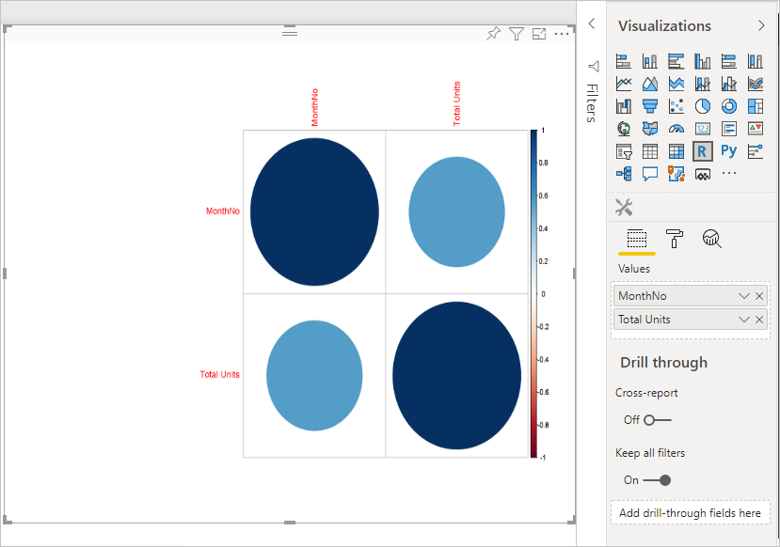
3. Creating custom visuals
R and Python visuals can be created by selecting the R or Python visual options in the Power BI report view.
Scripts run within these visuals generate plots or graphics, which Power BI displays as custom visuals in the dashboard.
These visuals are highly customizable and can include complex charts like density plots, clustering diagrams, and predictive modeling visuals.

Slide 8
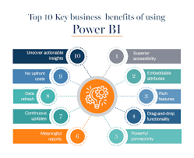
4. Applications and benefits
Advanced Analytics: R and Python offer rich libraries for statistical analysis and machine learning, enabling more sophisticated analytics directly in Power BI.
Enhanced Data Cleaning: Use R and Python for complex data transformations that go beyond Power BI’s native options.
Custom Visualizations: The libraries in both languages allow for unique visualizations not natively available in Power BI, adding depth to reports and dashboards.

Slide 9
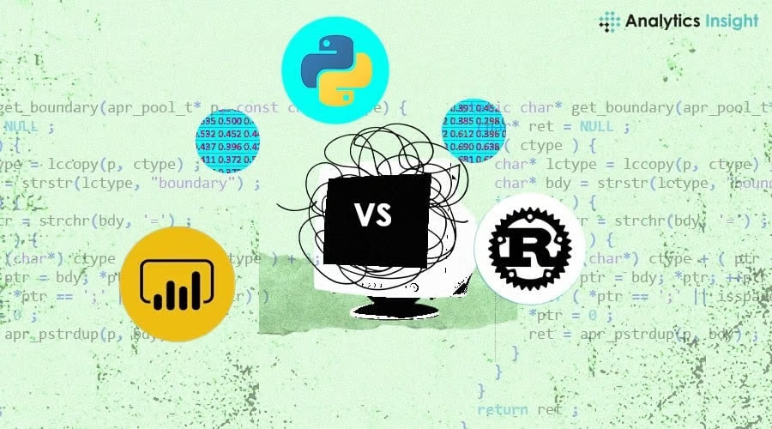
5. Limitations and considerations
These scripts are run locally and require R and Python installations on the machine running Power BI. Published reports in Power BI Service may not support R and Python visuals unless a Power BI Premium account is used.
Scripts may impact performance if they involve intensive computations.

Slide 10
Conclusion
Integrating R and Python in Power BI brings a powerful combination of advanced analytics and custom visuals to data analysis. This integration allows data analysts to extend Power BI’s functionality, leveraging the statistical and visualization capabilities of R and Python for more insightful and customized reporting.

Slide 11
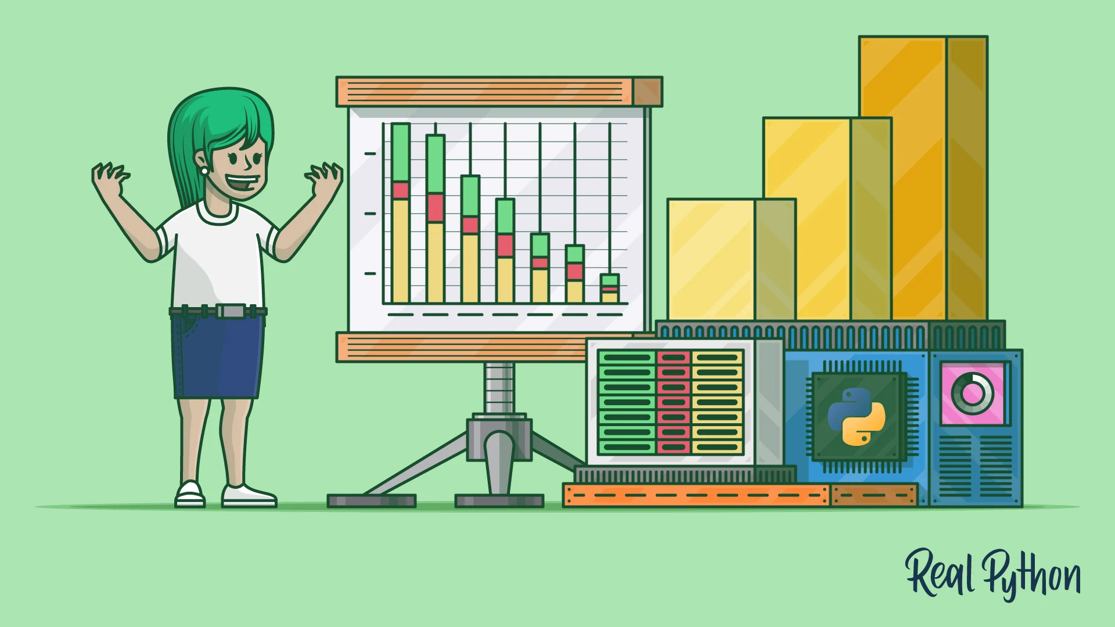

Thank you
ajaycraju98@gmail.com

